Slide 1
FarmBeats Accelerator
Microsoft Capstone 2020
Jack Morris
Henry Brewster
Matthew Brock
Zachary Miller

Slide 2
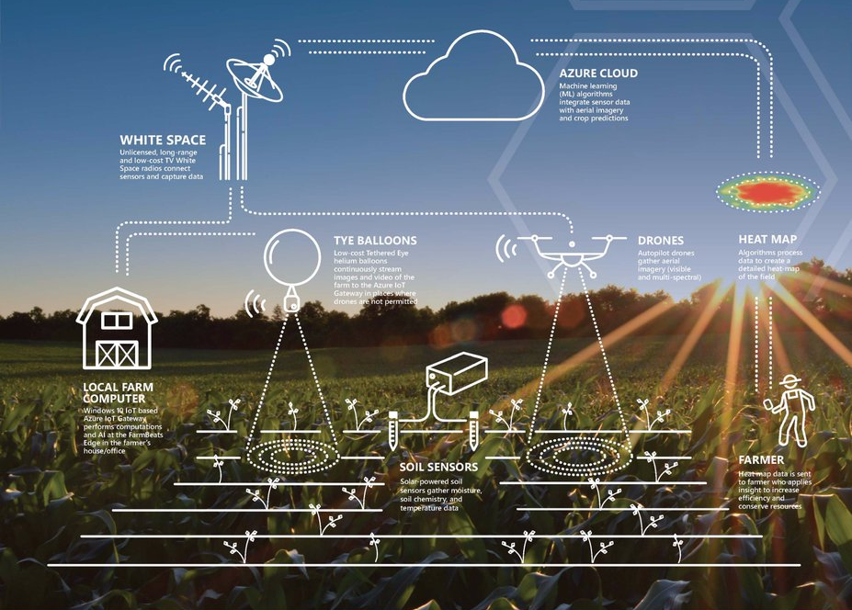
What is FarmBeats?
Microsoft platform that facilitates data-driven farming
Extensive monitoring system composed of sensors, drones, cameras, and Azure Cloud integration
Aims to improve yields, lower costs, and reduce the environmental impact of farming.

Slide 3


Capstone Goals
Create Power BI reports that visualize FarmBeats ground sensor data
Create a web app that will aid the NDSU Precision Ag department
Provide students and researchers with easy-to-analyze visuals of sensor output.
Document the entire process for future development

Slide 4

Capstone Deliverables
Web API
Power BI Reports
Web app with embedded Power BI reports
Development documentation

Slide 5

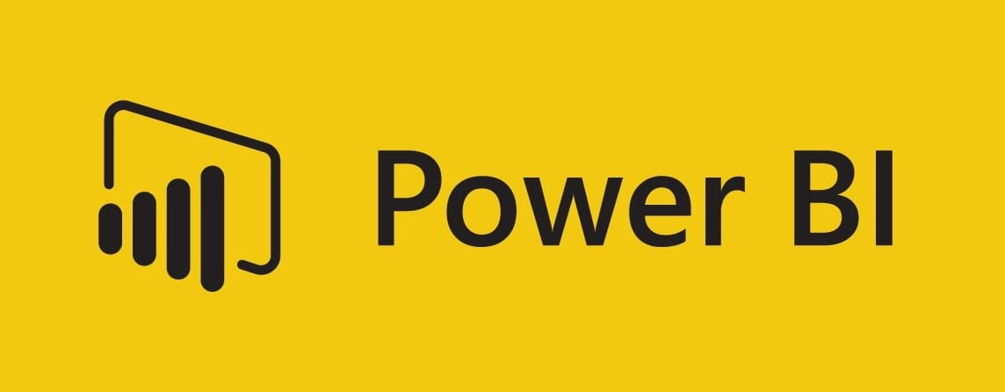


What we’ve accomplished:
Sprint 1:
Set up all necessary accounts, directories, applications
Discussed project goals with Microsoft + Precision Ag department
Sprint 2:
Completed a base Web API – Research preview
Iterated through many Power BI report designs

Slide 6
What we’ve accomplished (cont.):
Sprint 3:
Started shifting the API from Research to Public Preview
Integrated API data with Power BI (Report backend reconfigured)
Sprint 4:
Created a web app that displays an embedded Power BI report
Continued shifting the API over to Public Preview
Full development Specification/Documentation
Added drill through functionality to Power BI reports

Slide 7
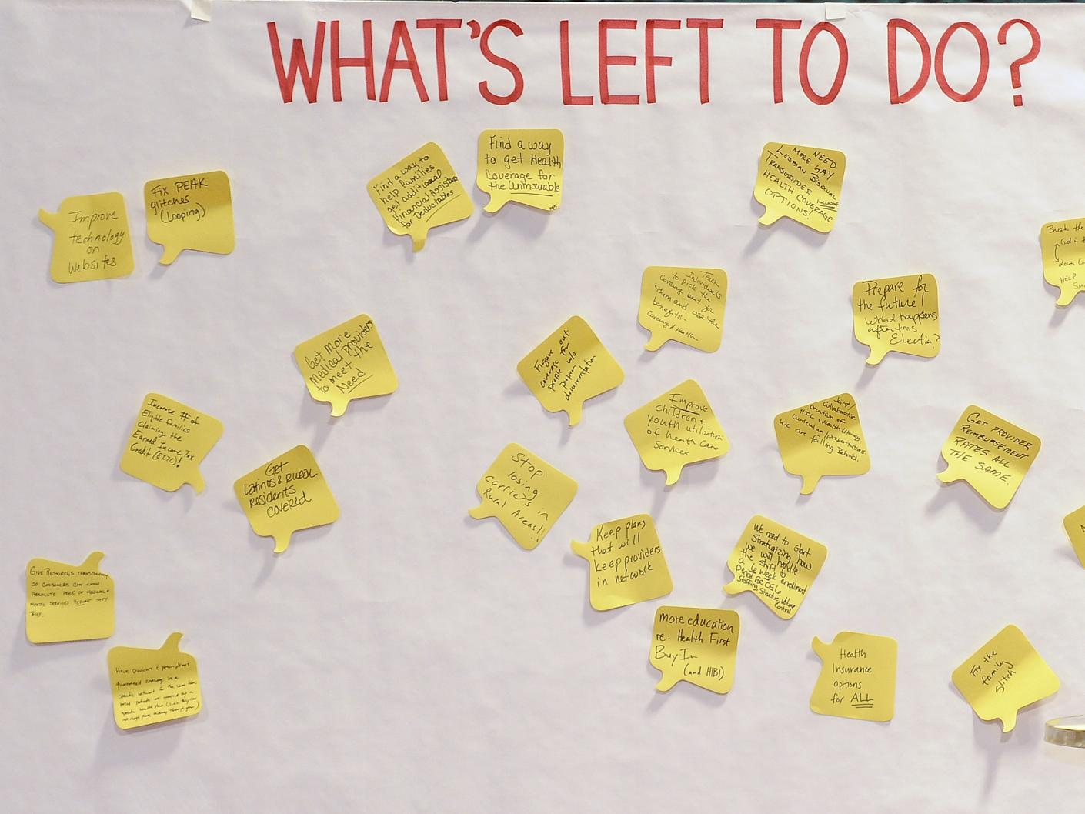
What's Left:
Finish up the Public Preview Web API
Add coordinate button functionality (requires API)
Create a short (5 min) demo video

Slide 8
Web API

Slide 9
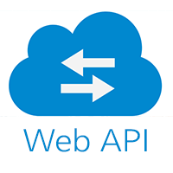

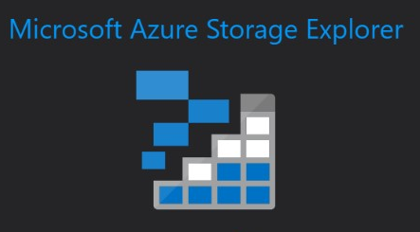
Web API (Research Preview)
Learning about C# Web API’s
Spent the first few weeks on how to implement Web API’s in C#
SQL vs NoSQL
Started out thinking that we were hitting a SQL server and then had to switch methodologies to hit a NoSQL server
Cosmos DB vs Azure Storage accounts
Started out thinking that the data meeded to be funneled through Cosmos DB and then adjusted to direct query the storage accounts

Slide 10
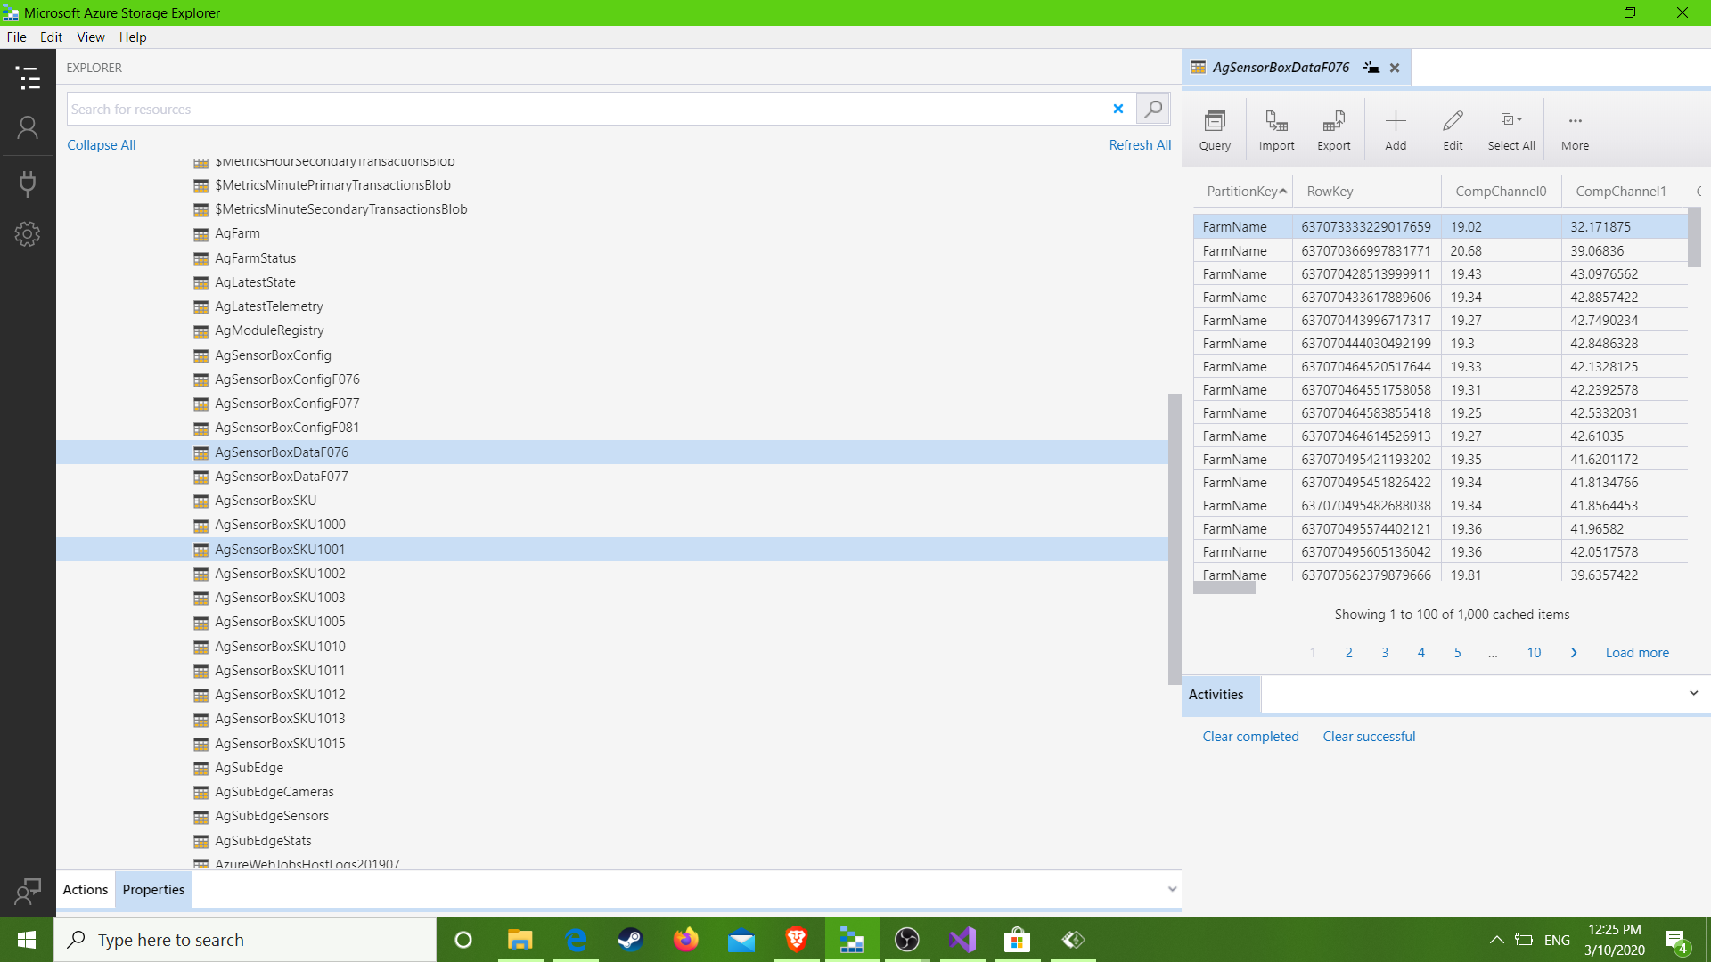
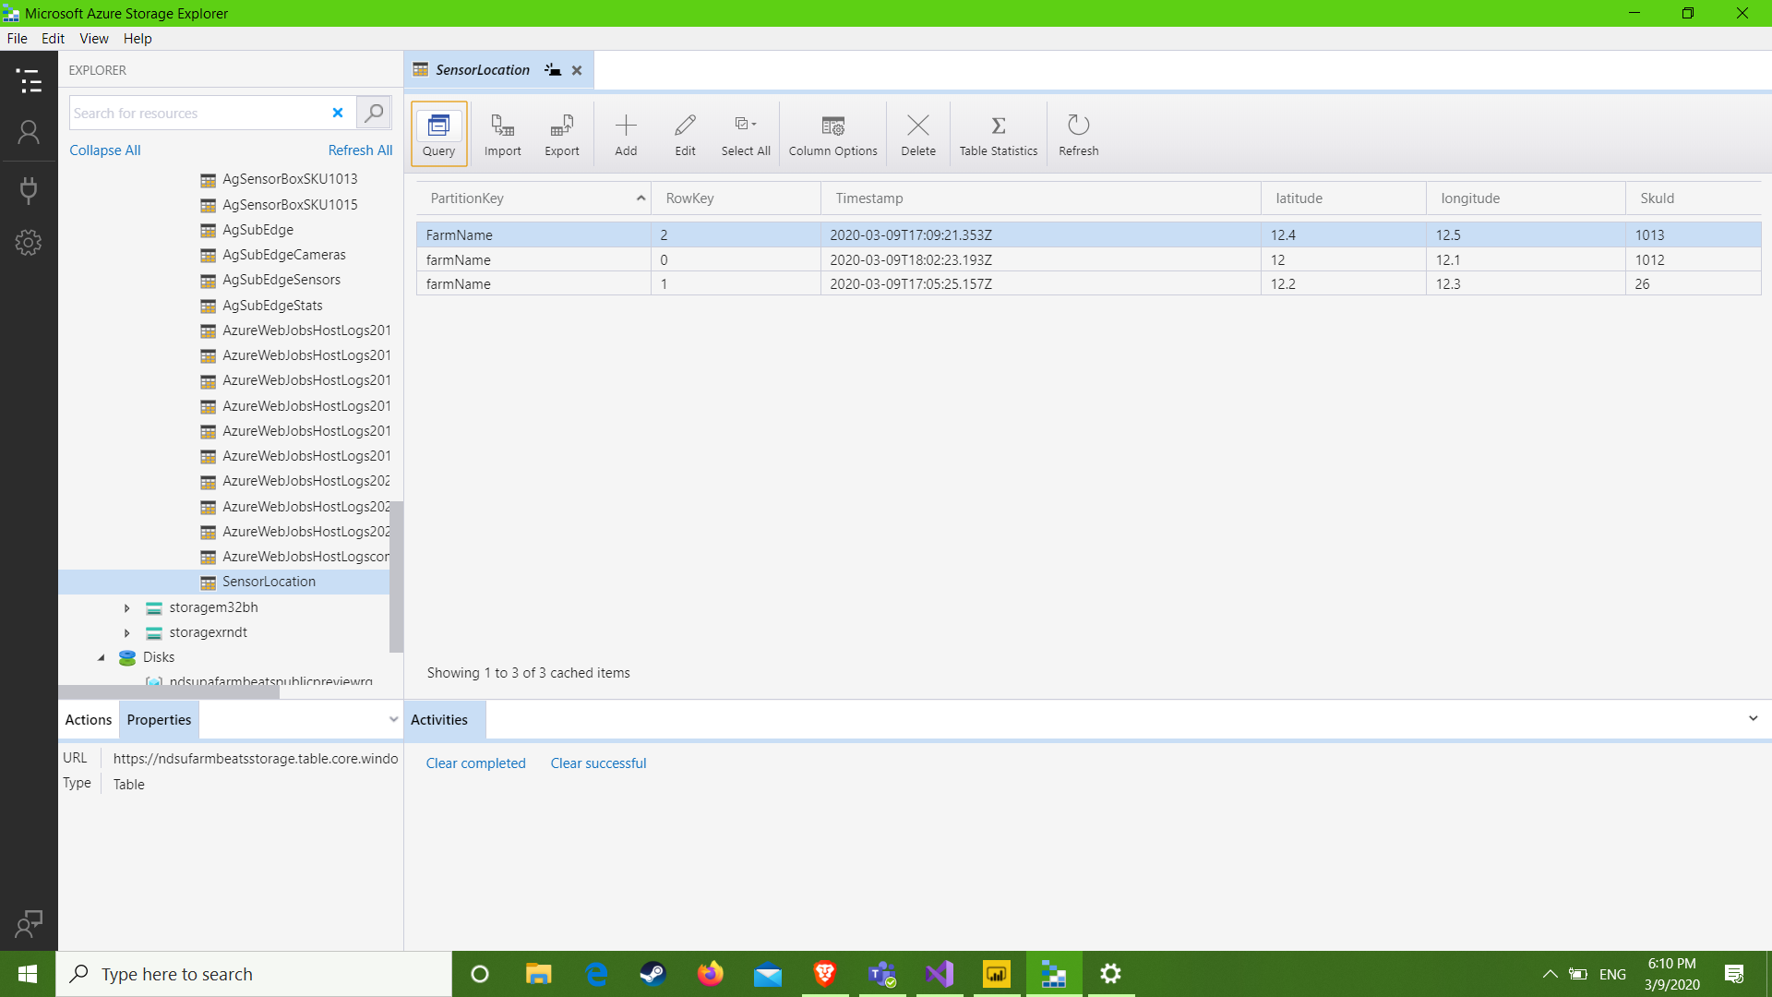
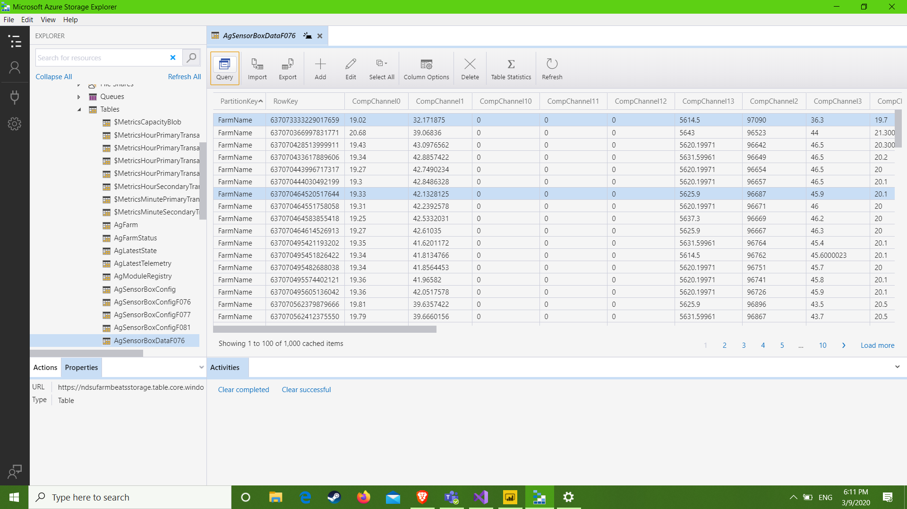
Table Data (Research Preview)

Slide 11
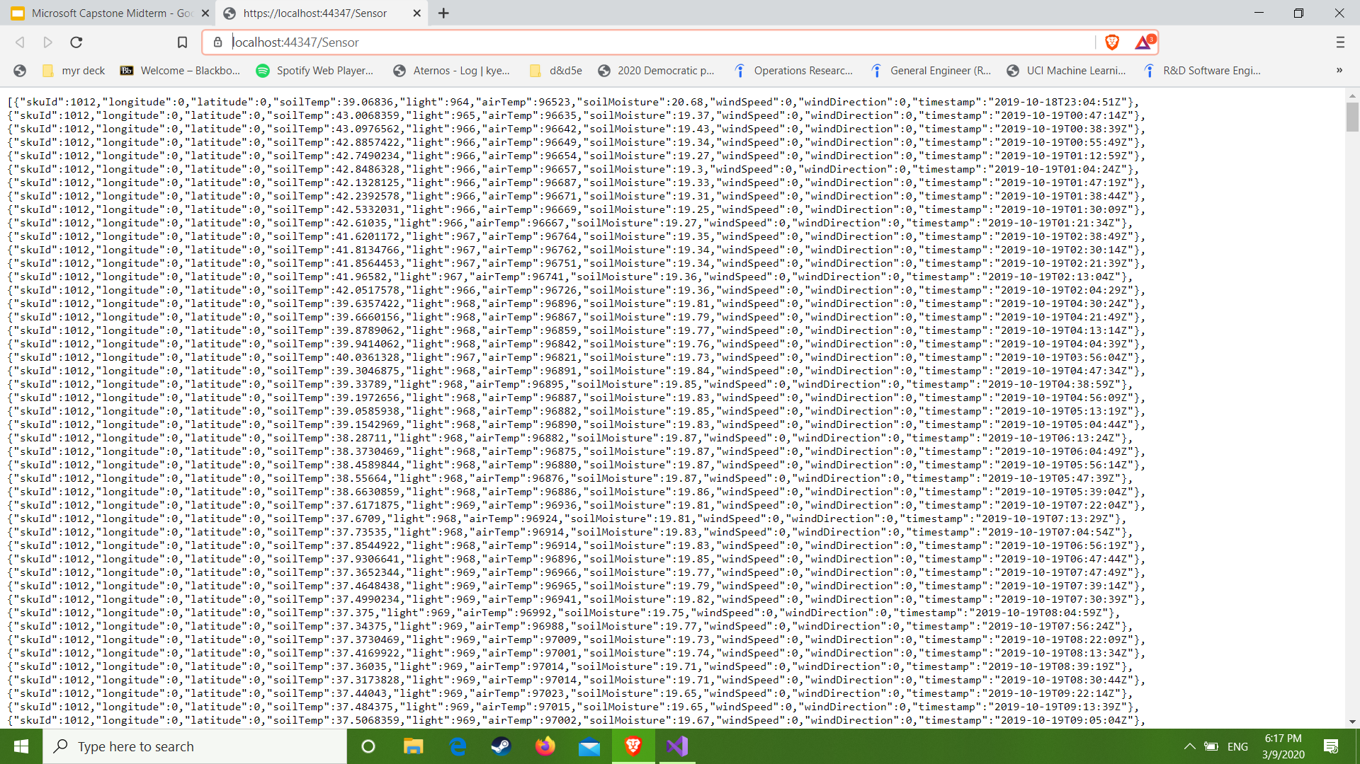
Output data(Research Preview)
SkuID, Latitude, Longitude, soilTemp, light, airTemp, soilMoisture, windSpeed, windDirection, Timestamp

Slide 12
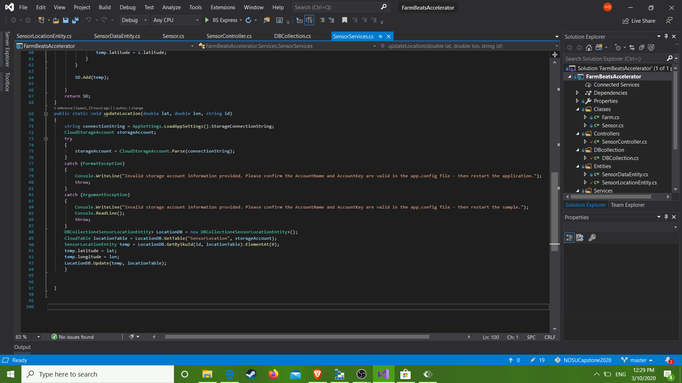
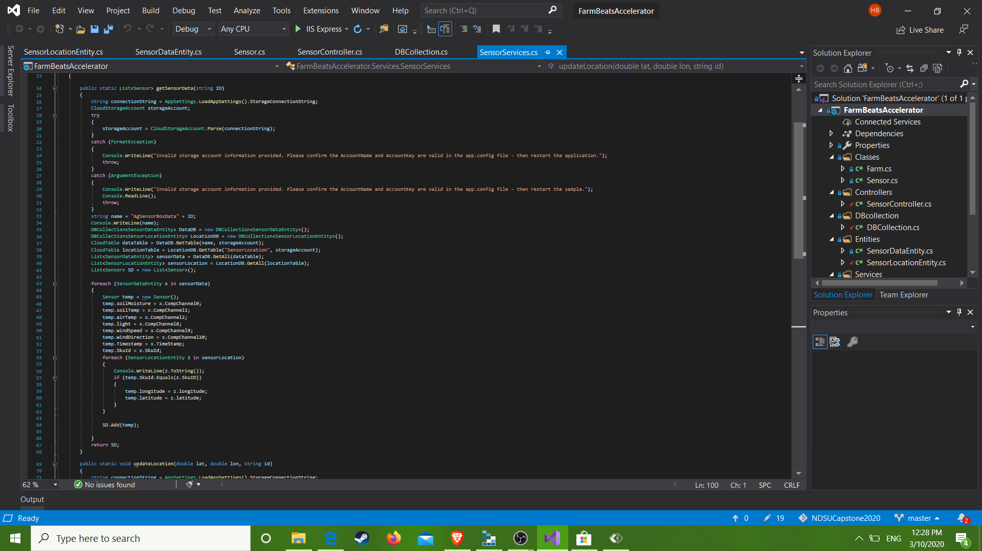
Services(Research Preview)
GetAll()
A default call that queries all the various tables for their data transforms it and then returns it
UpdateLocation()
Takes a longitude and Latitude and then updates the SensorLocation table

Slide 13


Web API (Public Preview)
Learning the FarmBeats Web API
Spent the first few weeks of sprint 3 figuring out how the FarmBeats Web API works
HTTP Requests
Created all the requests in postman to test them and get them working
Authentication with OpenID
Needed a way to get an acess token for our http requests so we built in OpenID to the Web API

Slide 14
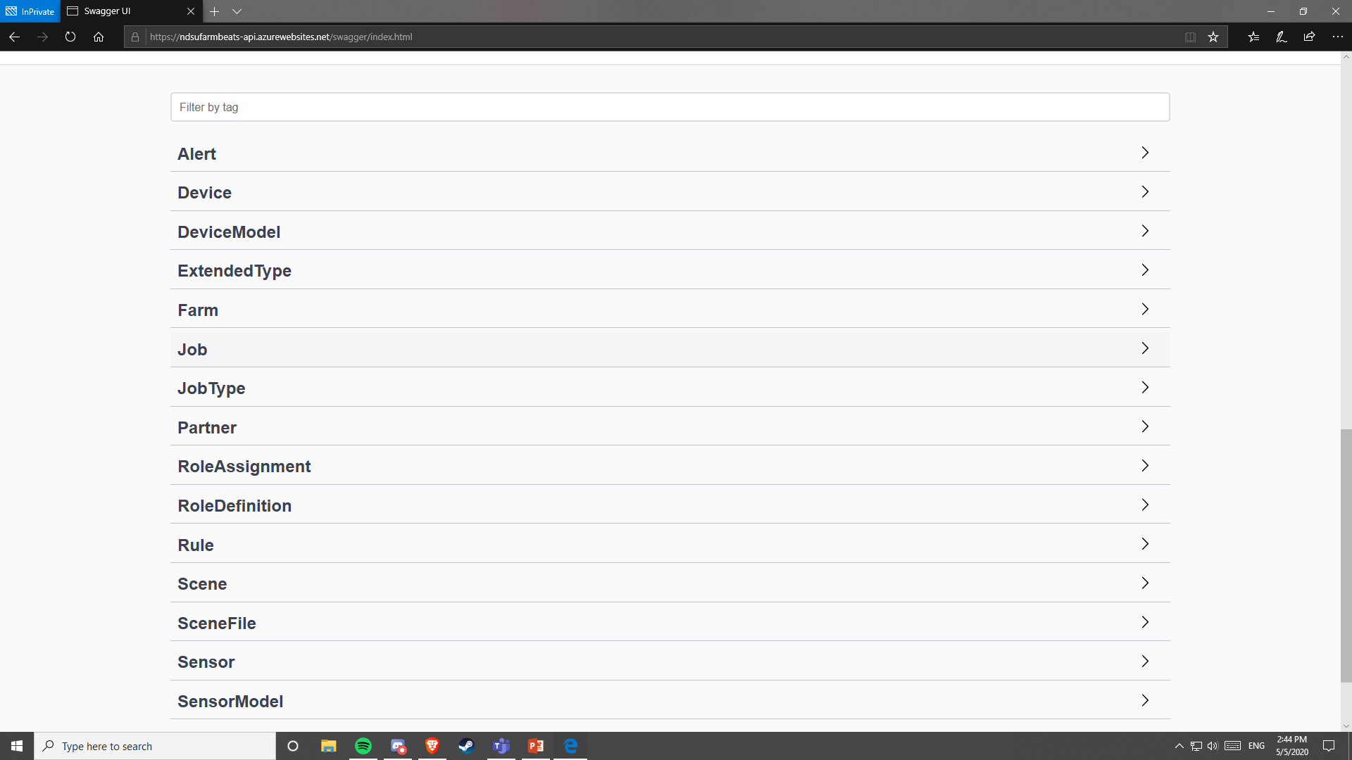
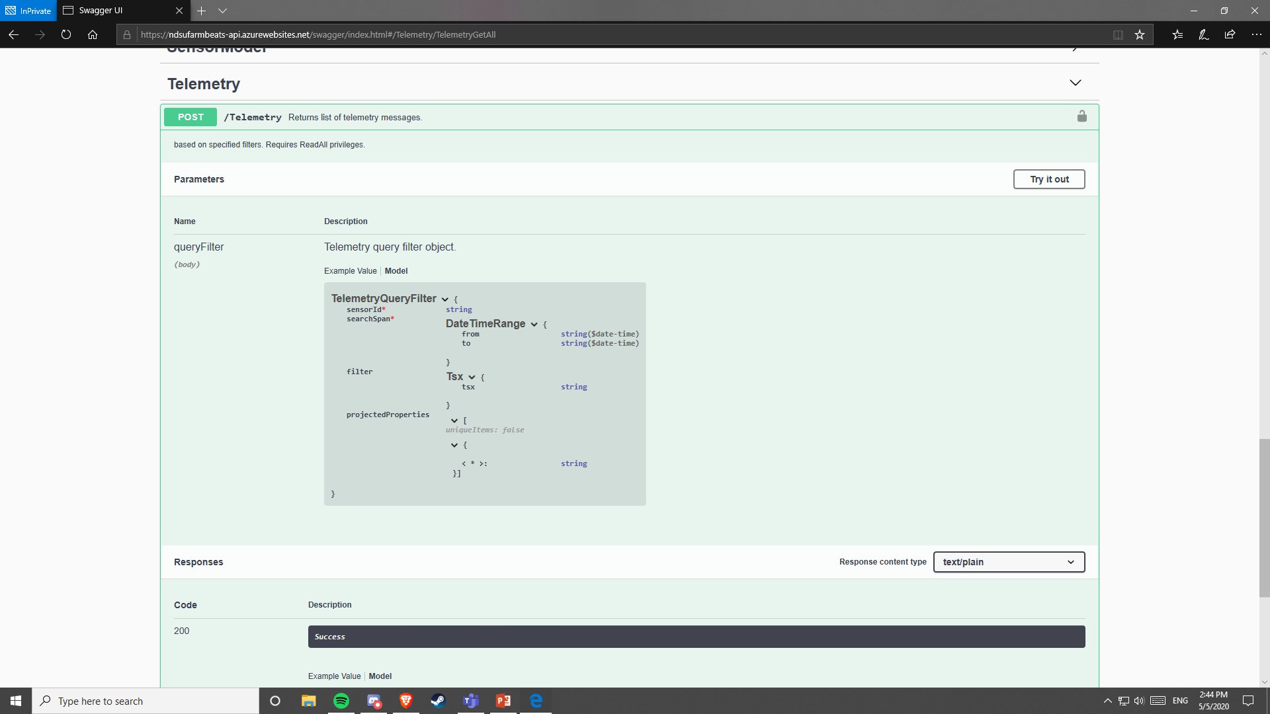
FarmBeats Web API
The Input for our Web API is the FarmBeats Web API
We take the telemetry of each sensor and then list it out as entries so that we end up with a list of all readings

Slide 15
Services
GetALL()
A post method that takes an access token for authentication and returns all of the sensor data
Update Location()
Takes in a longitude, latitude, and access token and then updates a sensors location

Slide 16
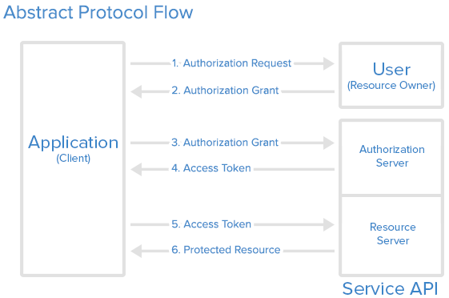
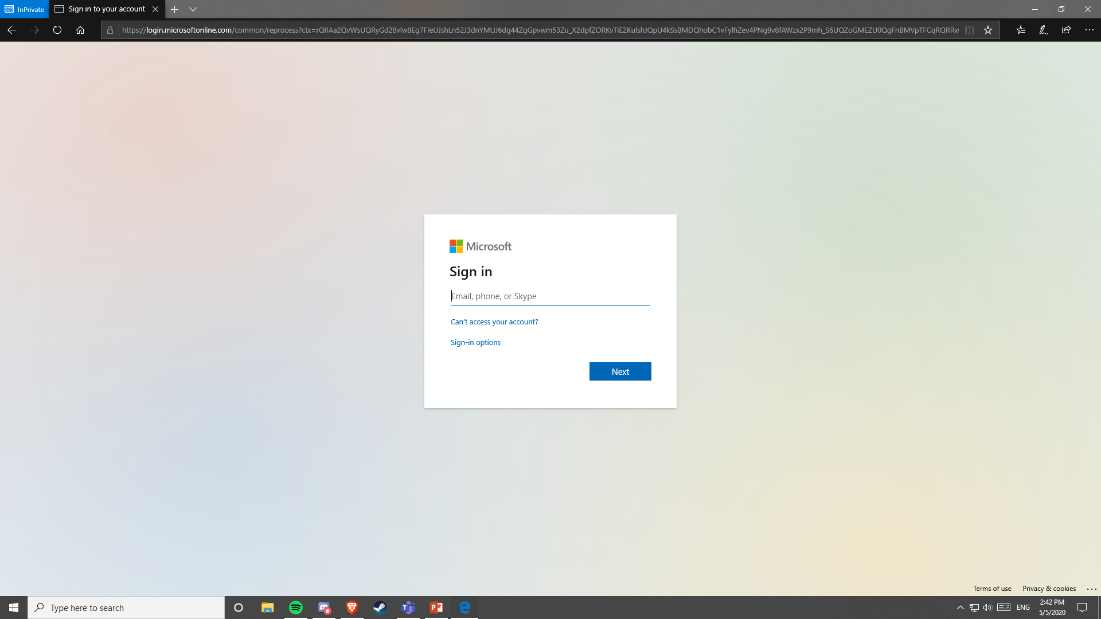
Authentication
OAUTH2.0
The authentication uses OAUTH2.0 protocols
OpenID
Used OpenID to allow the user to log in with their NDSU account to access the Web API

Slide 17
Web App / Power BI

Slide 18
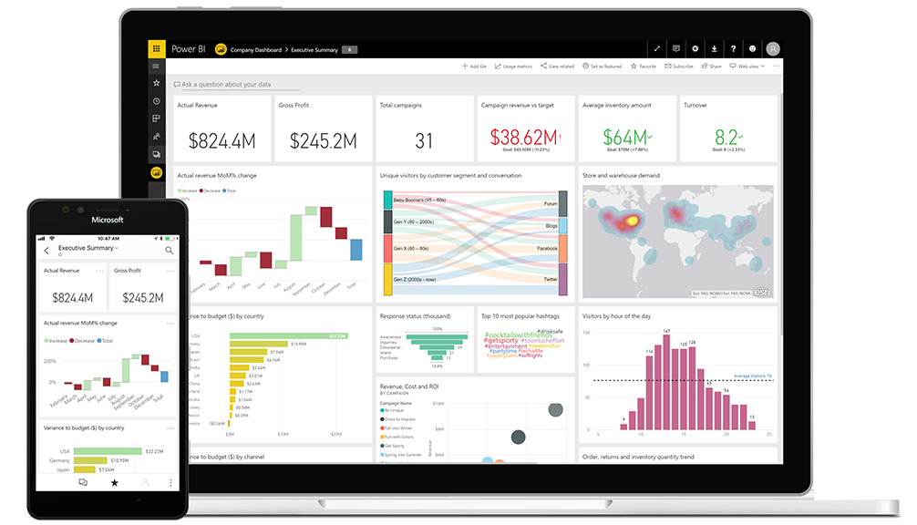
What is Power BI?
Analytics Software by Microsoft
Extremely useful for data visualization
Helpful to find trends in data
Can be embedded into apps/web pages

Slide 19
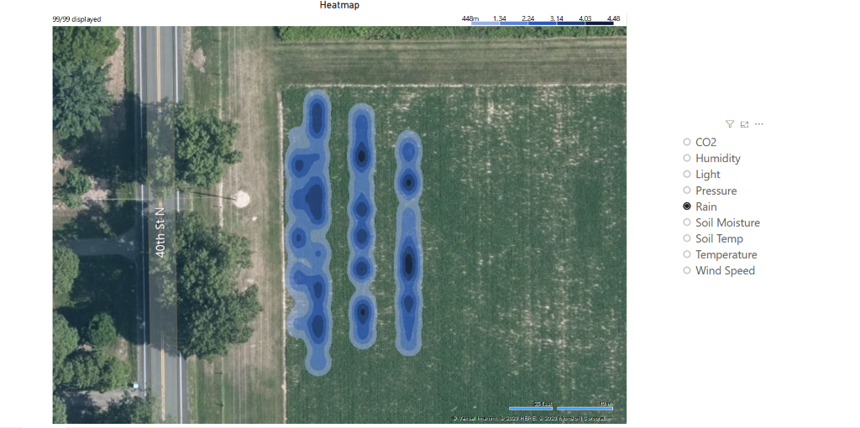
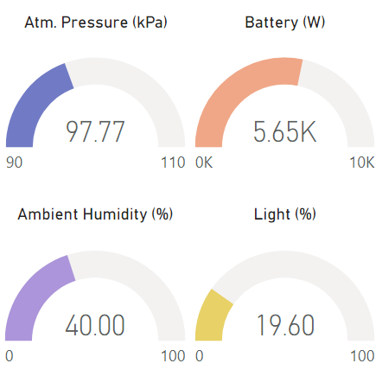
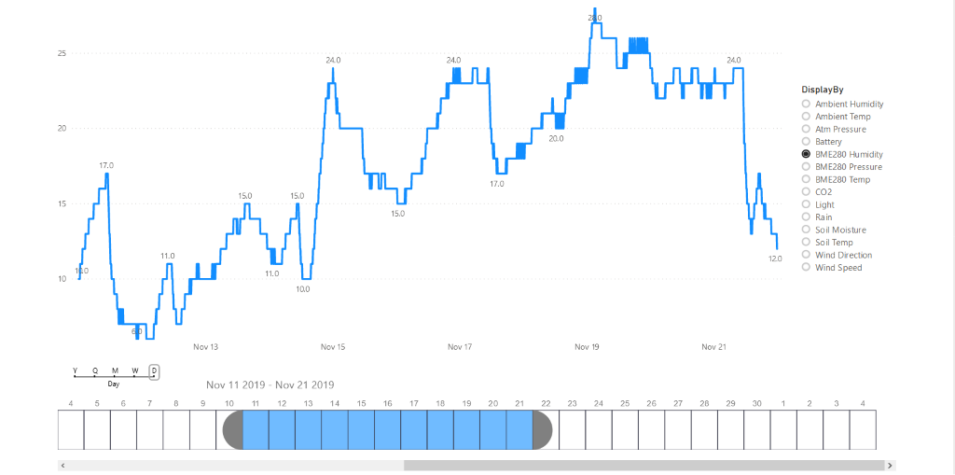
Design
Main page:
Sensor map
Drill though reports:
Gauges
Line Charts
Heatmaps
Reports are filtered by drill though, and can be filtered by any time interval

Slide 20
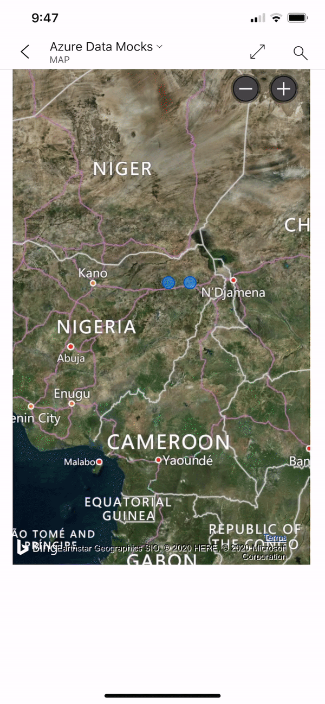
Mobile View
We also have added separate mobile layouts for each report page
Data is rearranged for vertical scrolling
Mobile layouts will be automatically used when a mobile device is detected

Slide 21
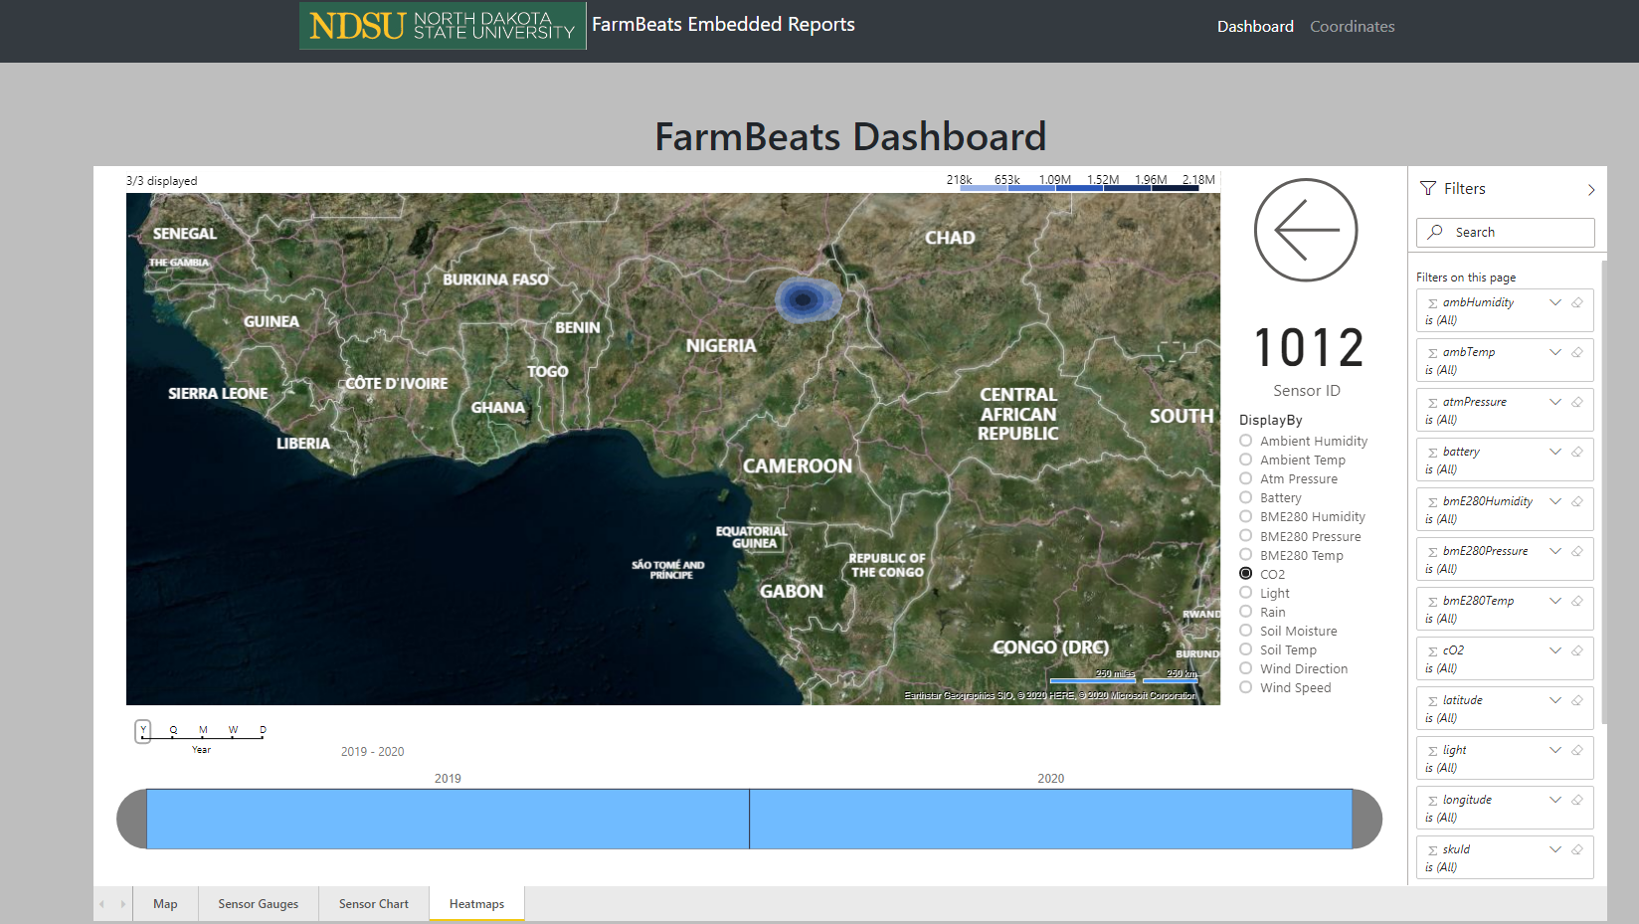
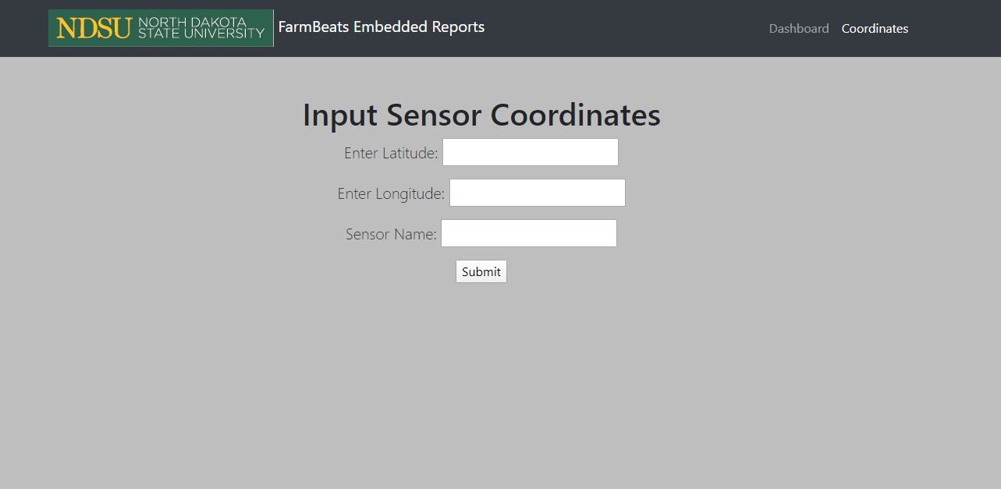
Embedded Power BI Report
A simple web page which contains the embedded Power BI report
With drill-throughs, only one page is needed for the entire report
Coordinates page is used to input the name and coordinates of a sensor

Slide 22

Web App Demo

Slide 23
Postmortem

Slide 24

Issues
The FarmBeats public preview was not deployed until after spring break (End of March)
This caused many API development holdups near the end of the semester
IoT data simulation was unsuccessful due to issues with Azure

Slide 25
Thoughts on Microsoft Tools/Platforms used
Power BI
Really intuitive +
Great visualization of data +
Visual marketplace is nice +
Azure
Account issues -
Convoluted systems -
Confusing documentation -
Visual Studio
Great customizability +
Great templates +
NuGet package errors -
FarmBeats
Database Schema is hard to work with -
Great Web API +
Simple/easy preview website +

Slide 26

Reflection
Even with constraints caused by the public preview delay and COVID-19, we still feel like this Capstone was a success
The Power BI reports look great
Our Web App/API can be easily hosted on Azure at any time
Future development can pick up where we left off using our documentation

Slide 27
THANKS FOR A GREAT SEMESTER!
Questions?

